Slide 1
RETIREMENT ANALYSIS 2014-2021
Swapna Vuthpala
Braydon Nugent
Gayan DSilva

Slide 2
Objective
The objective is to investigate whether specific professions result in early retirement .
What factors influence early retirement.
How has retirement age changed overtime for everyone

Slide 3
Data collection
We have collected data from Australian Bureau of Statistics.
By examining retirement age data across various professions, we aim to identify any patterns, trends that suggest a correlation between a person's occupation and the age at which they retire and how it inclined over time.

Slide 4
Hypothesis
We believe the main reasons for retirement at a younger age is consistent with:
positive factors including; financial freedom within household & super contributions.
negative factors including; well as negative factors such as; injury or illness, health conditions or capability within the job itself.

Slide 5
Do retirees in certain professions choose to retire early?
explore patterns
look for specific professions
Do Comparative Analysis

Slide 6
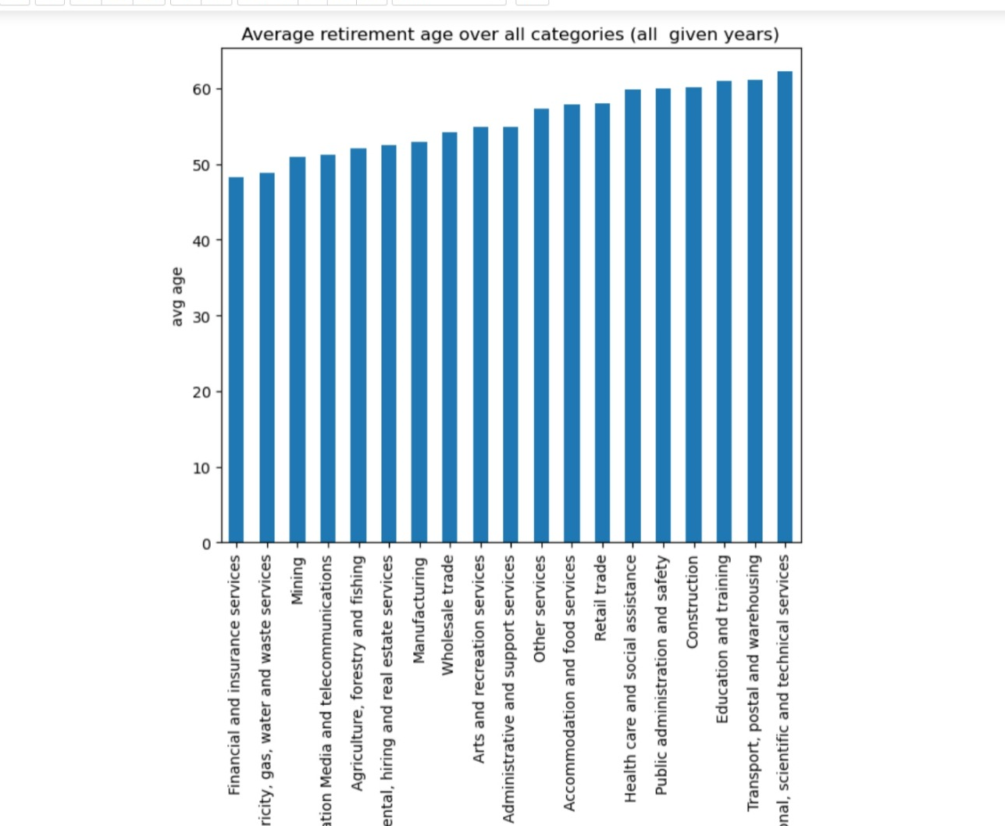
Average age of retirees by profession 2018-2020
Early Retirement Industries:- Categories such as Financial and insurance services, Electricity, gas, water and waste services, and Mining have notably lower average ages at retirement, suggesting that individuals in these industries tend to retire relatively early. i.e. at average age 48.16 and 48.83 .
Mid-Range Retirement Ages: -Categories like Manufacturing,Wholesale trade,and Arts and recreation services fall in the mid-range of average retirement age falls under 52.9 to 54.8
Later Retirement Industries: - Professions such as Professional, scientific and technical services, Transport, postal and warehousing, and Education and training have higher average ages at retirement, indicating a tendency for later retirement in these sectors .i.e. average age falls in 60.8 to 62.1

Slide 7
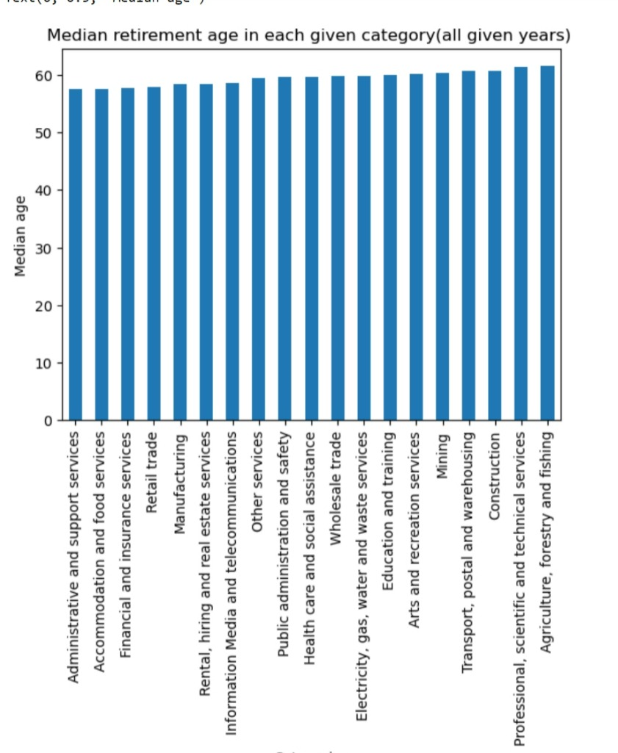
Explore patterns
Investigating potential patterns influencing retirement age and decision by calculating mean and median over all years
The lowest median values of average age for all categories are in the range of 57 to 58 years.
- Administrative and support services (57.4865)
- Accommodation and food services (57.6080)
- Financial and insurance services (57.7515)
- Retail trade (57.8765)
Highest Average Retirement Age: are in the range of 60 to 61 years. These include:
- Professional, scientific and technical services (61.3350)
- Agriculture, forestry and fishing (61.4775)
- Construction (60.7455)
- Transport, postal and warehousing (60.6655)
Mid-Range Average Retirement Age: (around 59 years) include:- Other services (59.4330)- Public administration and saf
- Health care and social assistance (59.6700)
- Wholesale trade (59.7155)ety (59.6490)
- Electricity, gas, water and waste services (59.7920)

Slide 8
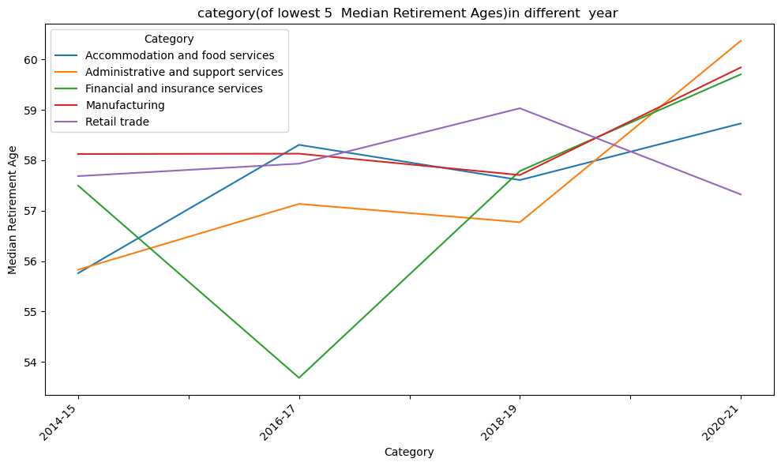
Median top 5 average age values and year(2014-2021)
Accommodation and Food Services
- The average age at retirement for this profession increased from 55.76 in 2014-15 to 58.73 in 2020-21. There's a general upward trend in retirement age over the years.
Administrative and Support Services
- The average age at retirement for this profession increased from 55.83 in 2014-15 to 60.37 in 2020-21. Similar to the previous profession, there's a noticeable increase in retirement age over the years.
Financial and Insurance Services
- The average age at retirement fluctuates over the years but generally increased from 57.50 in 2014-15 to 59.70 in 2020-21.
Manufacturing
- The average age at retirement for the Manufacturing profession increased from 58.12 in 2014-15 to 59.84 in 2020-21. There's a slight upward trend in retirement age.
Retail Trade
- The average age at retirement for Retail Trade fluctuates, with a decrease from 59.03 in 2018-19 to 57.32 in 2020-21. There's a notable decrease in retirement age in the most recent years

Slide 9
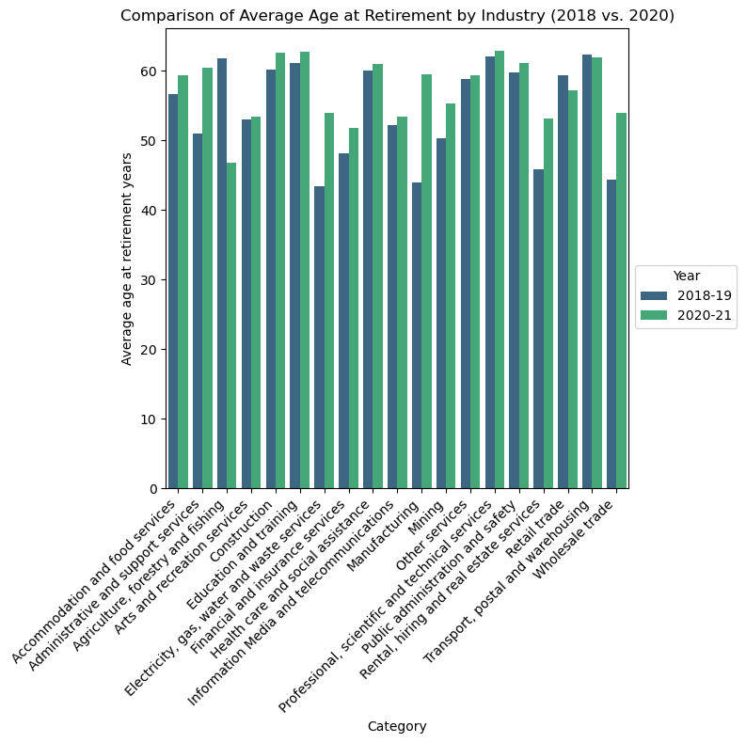
Trends Over Time Comparative Analysis:(2018-2021)
Highest Average Age at Retirement:
- Professional, scientific and technical services has consistently shown one of the highest average ages at retirement in both 2018-19 (62) and 2020-21 (62.8).
Lowest Average Age at Retirement:
- In 2018-19, "Electricity, gas, water and waste services" had the lowest average age at retirement (43.4), while in 2020-21, "Agriculture, forestry and fishing" had the lowest (46.7).

Slide 10
Points of data
Our analysis of average retirement ages reveals distinct patterns across professions. Industries such as Financial and insurance services,Electricity, gas, water and waste services, and Mining exhibit a consistent trend of early retirements.
So, it means some of professions retire early compared to other professions.
– Understanding these patterns is crucial for employers, policymakers, and individuals planning for their retirement.
– Further research, behind these trends and affecting factors can provide information to make future decisions.

Slide 11

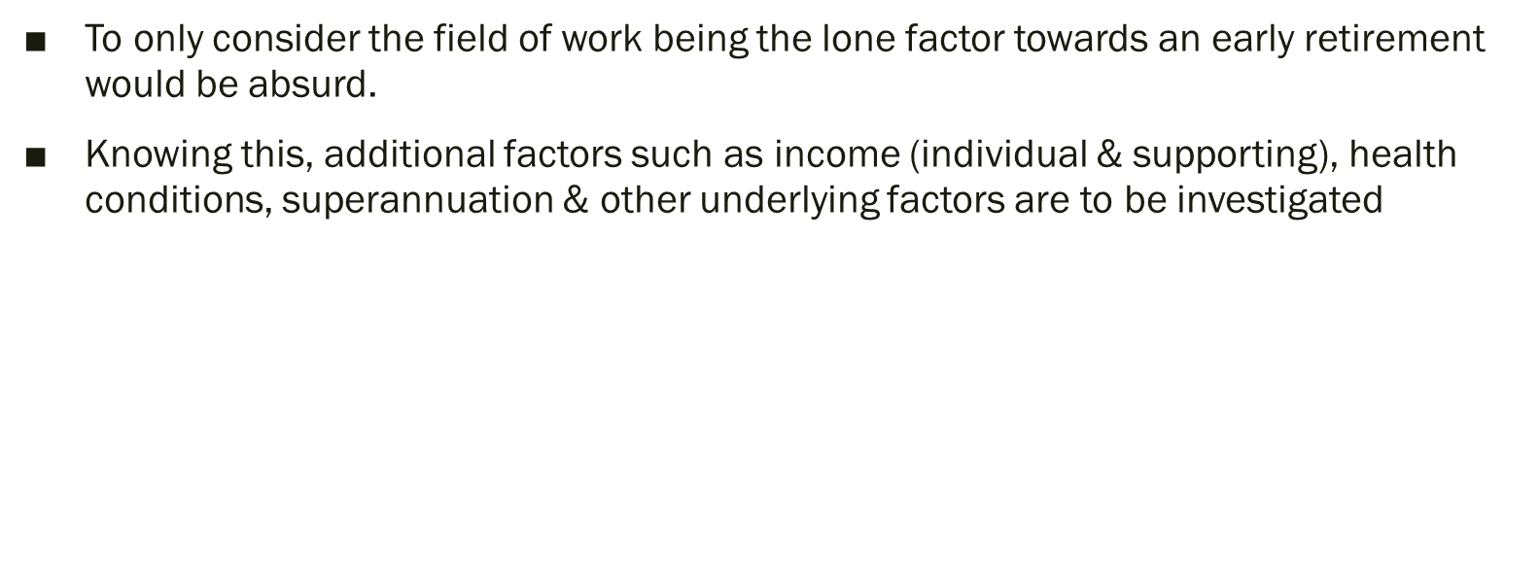

Slide 12
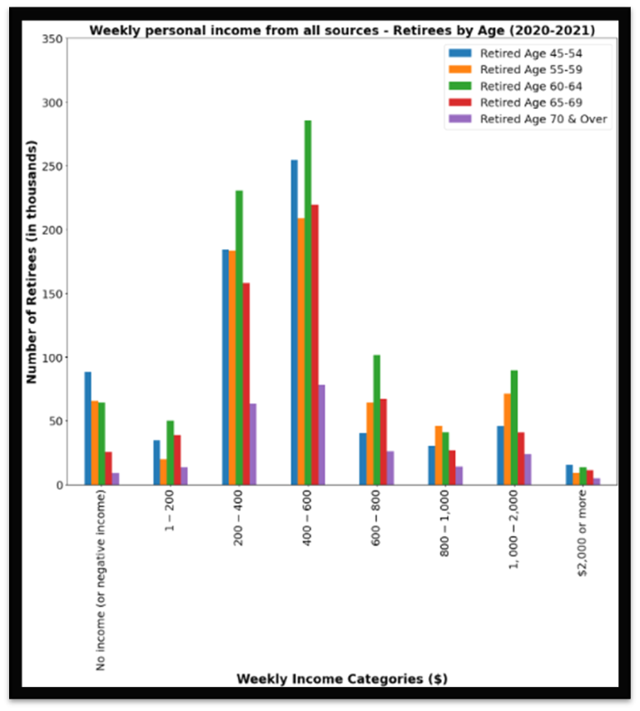
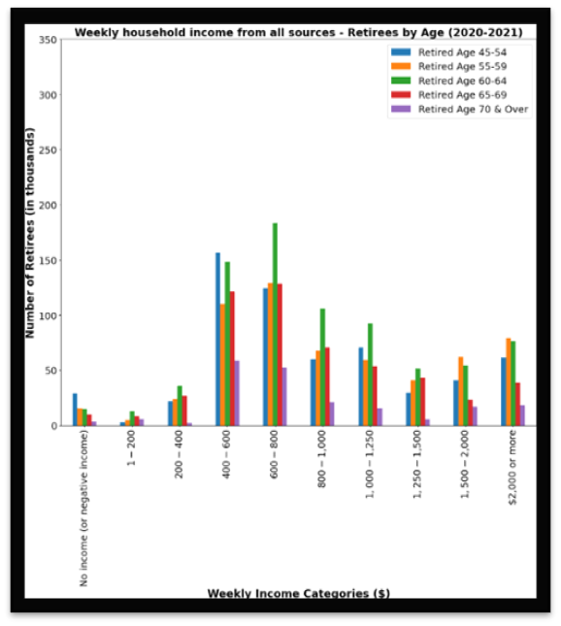
Pre-Retirement Income by Age
Pop: 3,058,512
Pop: 2,691,839
This chart representing the ‘Weekly household income’ naturally illustrates this samples pre-retirement income more consistent and sustainable, a result of having supporting income from household members.
In addition the data shows:
-based on the large difference in the data, the majority of retirees were reliant on supportive income.
-The majority of individuals with supportive income were still contempt with retiring on an income as low as $400 (even less among a small selection of data).
This chart representing the ‘Weekly personal income from all sources’ illustrates a large percentage of this sample had a pre-retirement income of less than $600
In addition the data shows:
-High range of people below 60 years of age retired with lower income.
-There are significantly less older groups (65 and older) of retirees who also appear to have a more consistent range of pre-retiring income.

Slide 13

Please Note!
The weekly individual income does represent the same sample population as the weekly household income
There are 366,673 retirees from this data who did not have supportive income from household members.

Slide 14
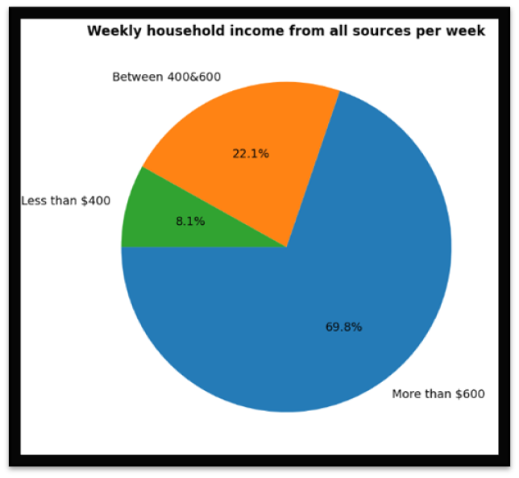
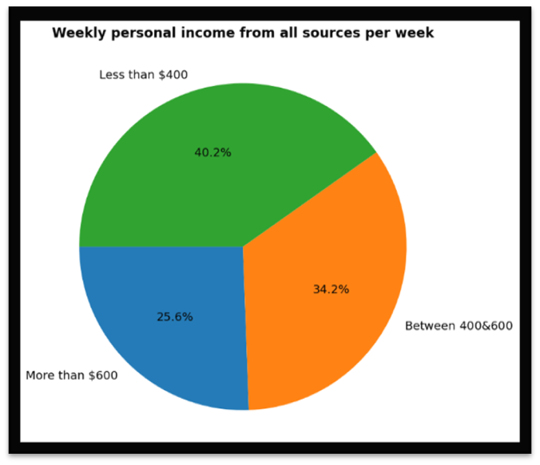
Further Analysis
An interesting point drawn from the data charting of pre-retirement income is despite the weekly household income having a naturally higher income, there was a significant population within the sample who were competent with an income between $400 & $600.
Alternatively, this data can be viewed 30% of the sample population had a pre-retirement income of less than $600 per week despite having supportive income.
From both sets of data, we can conclude that people are competent retiring with a relatively low pre-retirement income range even with supported income. We can also see a large population of the sample are retiring before the age of 60, which in principle is a capable working age, even in addition to having a lower income.
This suggests there are other underlying factors that are considered for an earlier retirement.

Slide 15
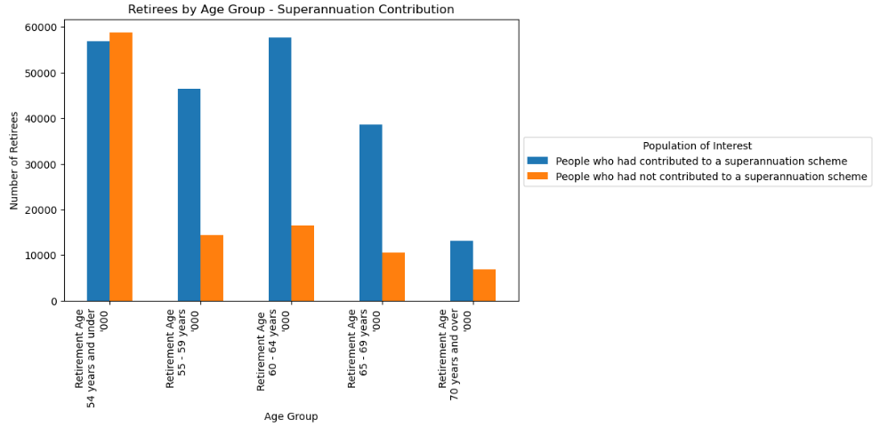
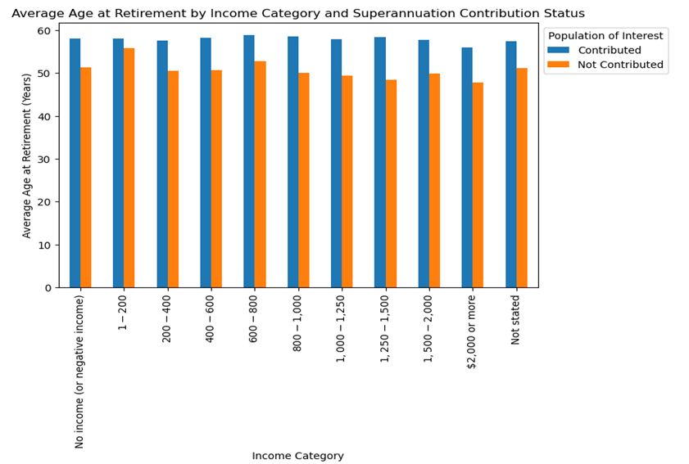
Analysis - Retirement Age by Income, Contribution to a Superannuation Fund, and Age Group
The bar chart below displays the number of retirees segmented by age groups and whether they have contributed to a superannuation scheme.
- Large number of retirees contributed to a superannuation scheme across all age groups.
- Consistent pattern showing fewer retirees as age increases, due to the transition from employment to retirement.
The bar chart below shows the average age at retirement by income and superannuation contribution status.
- Average retirement age across all income categories ranges closely between 50 and 60 years.
- Average retirement age of individuals who contributed to superannuation is slightly higher
- Overall, there is a trend that those with no or lower income tend to retire earlier compared to those with higher income, regardless of their superannuation contribution status.

Slide 16
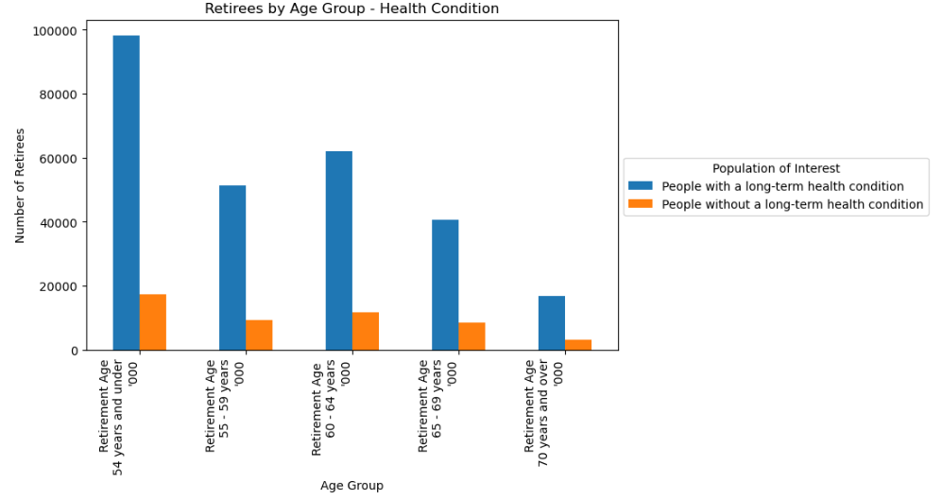
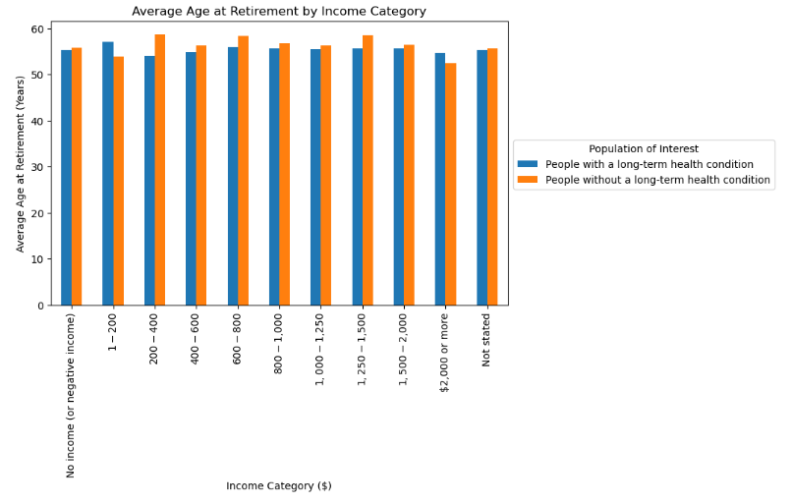
Analysis - Retirement Age by Income, Health Condition, and Age Group
The bar chart below depicts the distribution of retirees by age group, with a distinction between those with and without long-term health conditions.
- The age group ‘54 years and under’ has the highest number of retirees with a long-term health condition.
- For those without a long-term health condition, the numbers are consistently lower across all age groups when compared to those with a condition.
- This suggests that health issues are a significant factor in the decision to retire in the given population of retirees.
The ‘Average Retirement Age by Income Category for Different Health Conditions’, summarises -
- The retirement age tends to be slightly lower across most income categories for people with a Long-Term Health Condition, indicating that health issues might lead to earlier retirement. This trend is particularly noticeable in lower to middle-income brackets.
- The retirement age tends to be higher for people without a Long-Term Health Condition especially in higher income categories, implying that better health allows for extended working years, particularly among those with greater financial means.

Slide 17
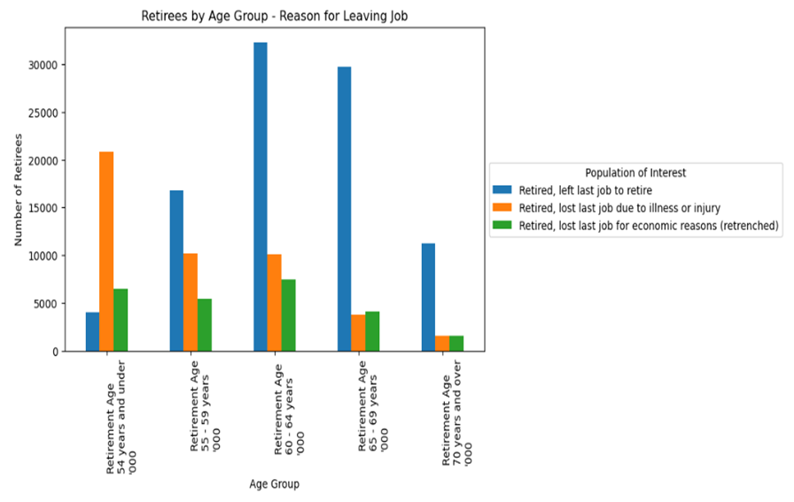
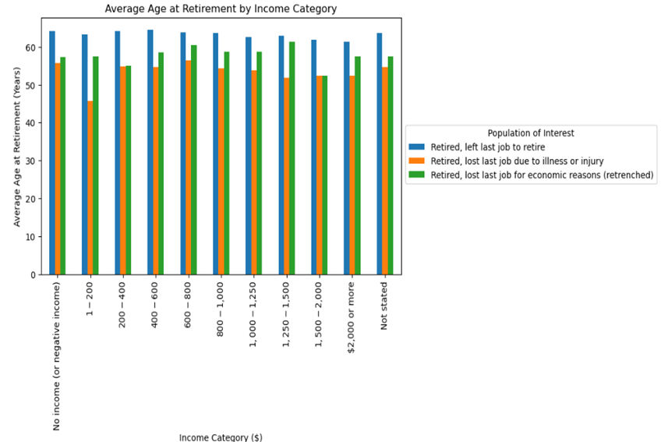
Analysis - Retirement Age by Income, Reason for leaving last Job, and Age Group
The bar chart below presents the number of retirees categorized by their age groups and reasons for leaving their last job.
- Majority of retirees in all age groups left their last job to retire, the age group ‘60-64 years’ having the highest number of retirees.
- There is a significant number of retirements due to illness or injury in the ‘under 54 years’ age group which decreases with increasing age.
- The trend shows that as age increases, the number of retirees decreases across all reasons.
Comparison of average retirement age with weekly household income and reasons for leaving the last job indicate that –
- The average retirement age across all income categories appears to be consistent at the near 60-year mark, suggesting that income may not drastically affect the decision of when to retire.
- Individuals who left their last job due to illness or injury tend to retire slightly earlier when compared to those who left for other reasons.
- The consistency of retirement age across income categories may indicate that other factors such as health, job satisfaction, and personal readiness play a significant role in the decision to retire than income alone.

Slide 18
In summary
Key Findings:
-Early retirement is not determined by pre-retirement income, nor via superannuation contributions.
-Early retirement is however proven to be indicative via the field of work.
-Labour induced jobs such as utility services & mining have significantly lower retirement ages. (Supported by the fact health conditions play a profound factor in early retirement).
-Educational services, & innovative careers poses higher ages of retirement.
-The significant reason for earlier retirement has been proven by the data to be a result of either injury or illness.
-This statistics is less progressive as the age range increases.

